Slide 1
Project Update
Weeks 1&2

Slide 2
Week 1: cleaned up existing code
Created (private) project GitHub at
https://github.com/2538354a/Simulating-THG-of-few-femtosecond-pulses-in-a-noble-gas-
Restructured code and updated output plots
Fixed errors in original version:
Hankel aperture radius should be 250µm, not 1mm
Intensity plots in old code plot λ=133nm instead of 266nm
(see next slide)
Despite of changes, old runs could be reproduced (see Sync&Share)

Slide 3
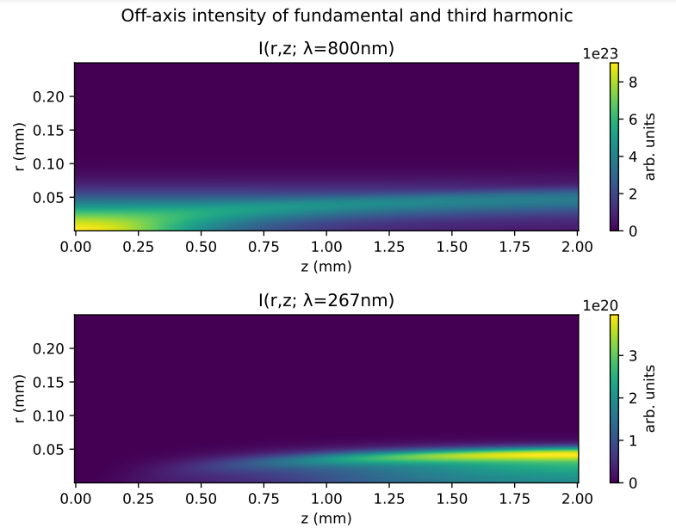
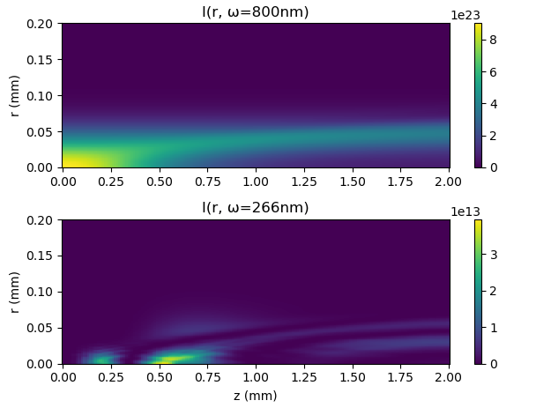
Error in intensity plots
new code

Slide 4
Week 2: added new features
Three new core features were added:
Option to base input pulse on measured time-intensity data
Tested with IR FROG data from Sync&Share
Option to overlay measured UV pulse for comparison
Tested with UV spectra from Sync&Share
Option to base gas density profile on measured/simulated density data
Untested due to lack of data: get COMPSOL files

Slide 5
1. Data-based input pulses
Previous approach modelled beam as Gaussian in both space and time
Now, a file with time-intensity data can be read in to determine the input pulse field
NOTE: requires a value for the CEO phase, has been set to zero so far
So far, spatial component still modelled as a Gaussian but this could be easily changed if appropriate data exists

Slide 6
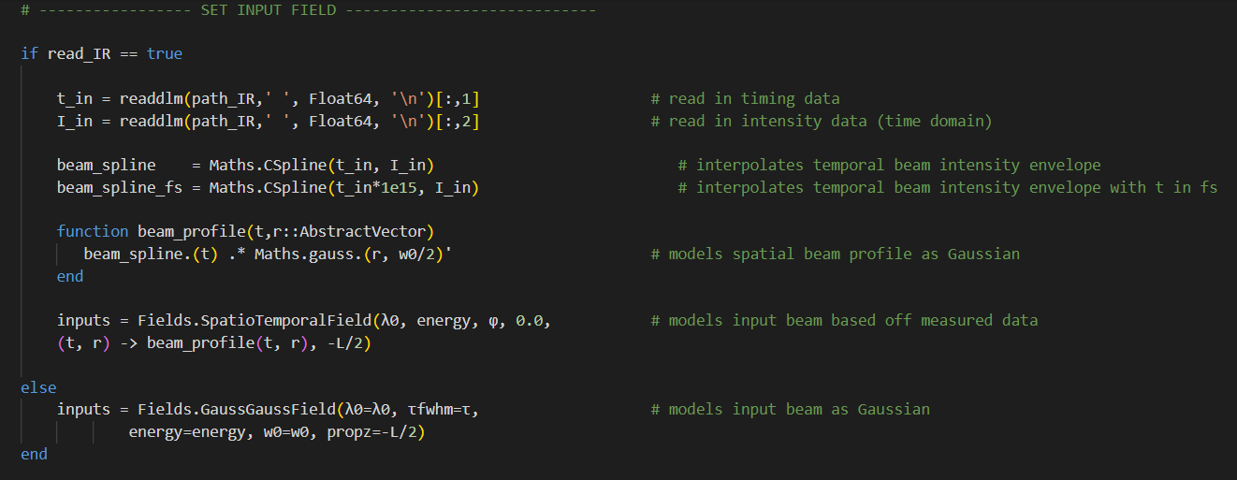
1. Data-based input pulses

Slide 7
2. UV spectrum overlay
Previously, the simulated UV spectrum could only be loosely compared to measured UV output
Now, a file with wavelength-intensity data can be read in and overlayed on the output spectrum
NOTE: the spectrum is rescaled in the process, so that a quantitative comparison is not (yet) possible

Slide 8
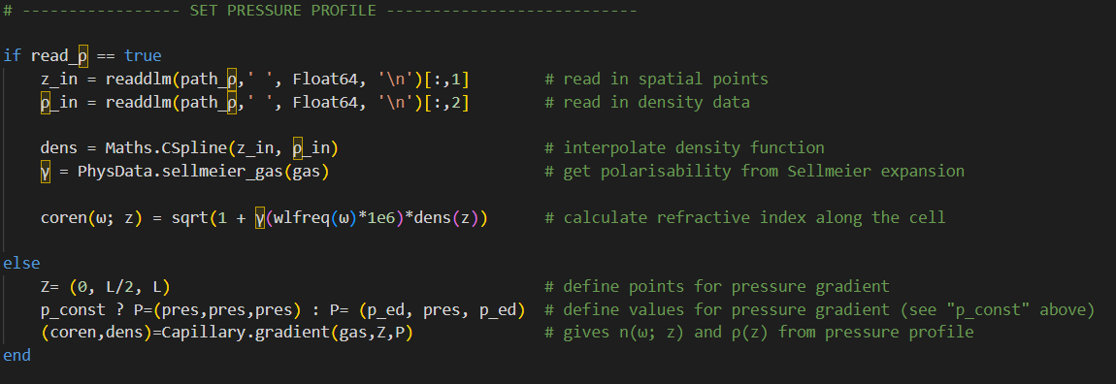
3. Data-based gas distribution
Previously, a simple gradient was used to model the gas distribution
Now, a data file with position-density data can be read in to determine the gas density and refractive index
NOTE: not tested due to lack of access to COMPSOL data

Slide 9
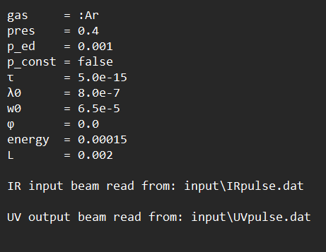
Example run
The follow slides show sample output for a run with parameter values:
Essentially standard settings with gradient approximation for pressure
Raw data from data files on Sync&Share, processed using a Python program called
“file_prepare.py” (also on GitHub)

Slide 10
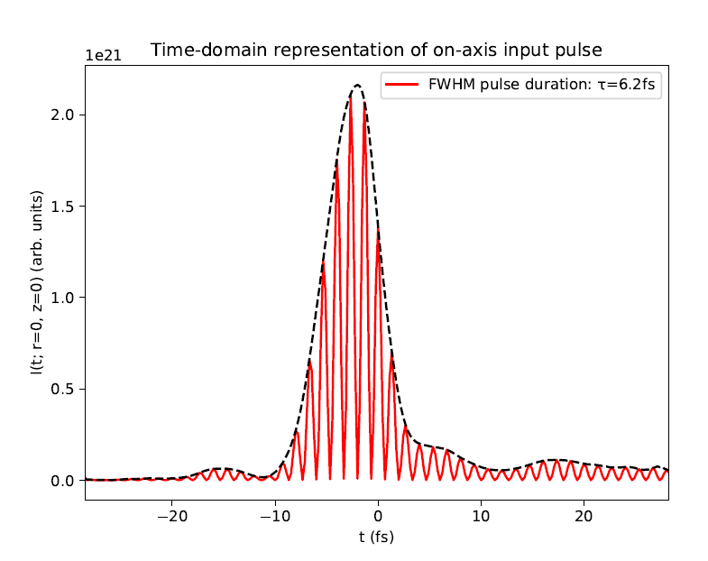
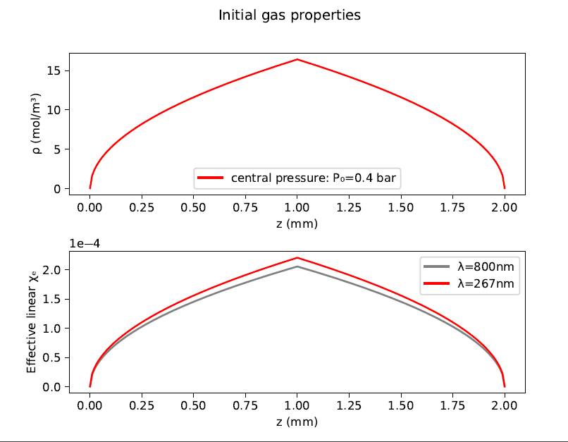
Example run

Slide 11
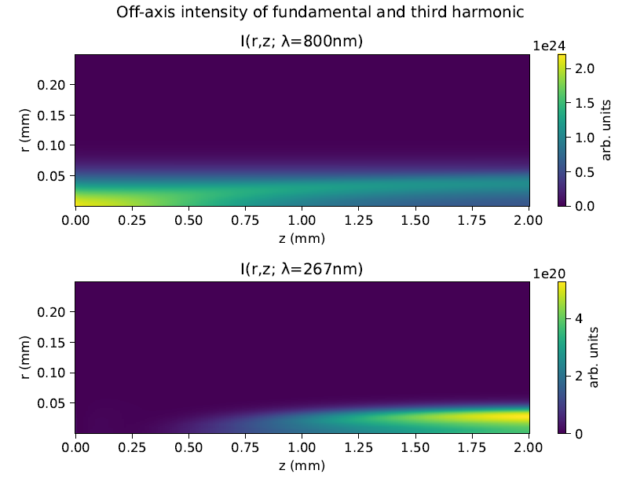
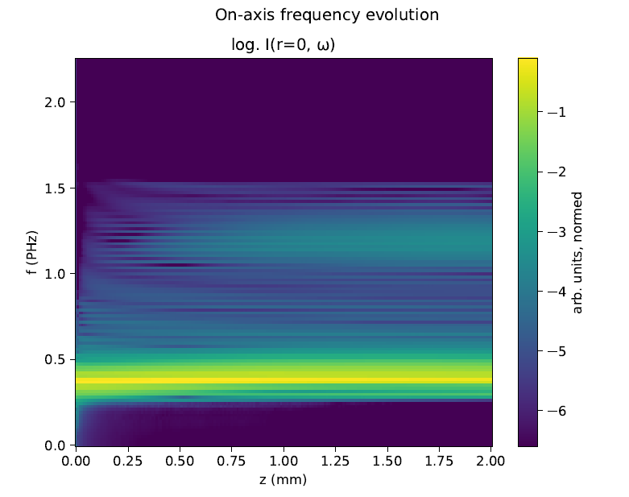
Example run

Slide 12
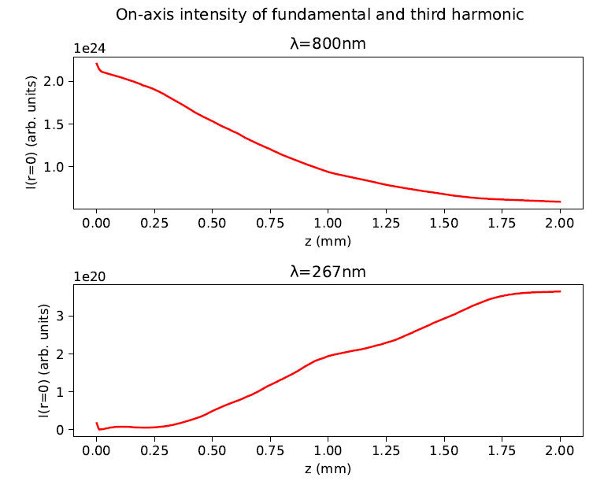
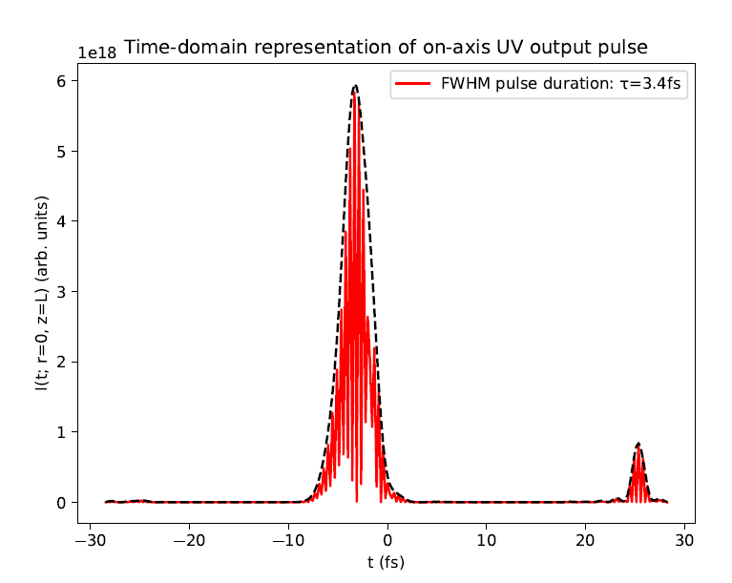
Example run

Slide 13
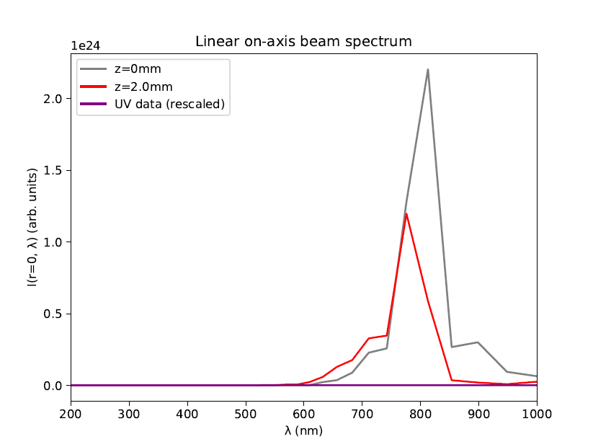
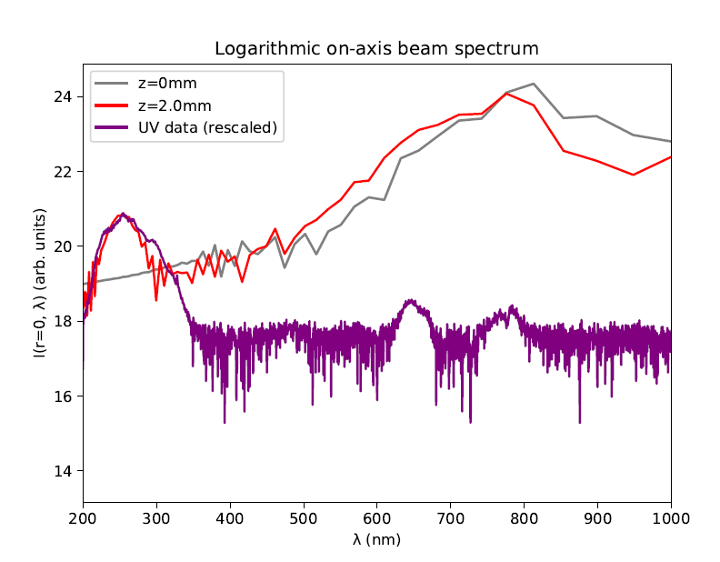
Example run

Slide 14
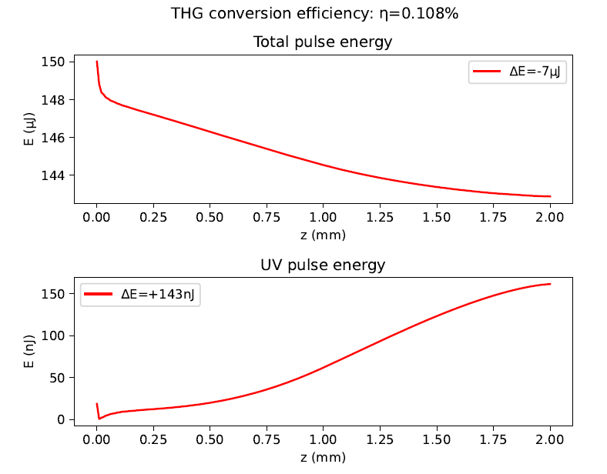
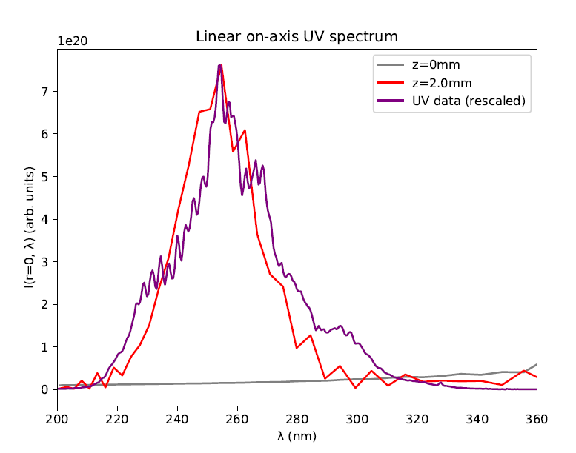
Example run
Measured pulse energy: 110nJ

Slide 15
Next steps
Get COMSOL simulation data for gas density
Potentially do more/improved simulations
Set up non-Gaussian spatial profile (?)
Measure CEO phase
Get more data:
Input pulses at different beam energies (75mW, 150mW, 300mW)
UV spectra at different beam energies and gas pressures (already on Sync&Share?)
Vary pressures and beam energies to try to reproduce pressure scans and find evidence of filamentation (change in beam shape, second spectral peak, saturation)

Slide 16
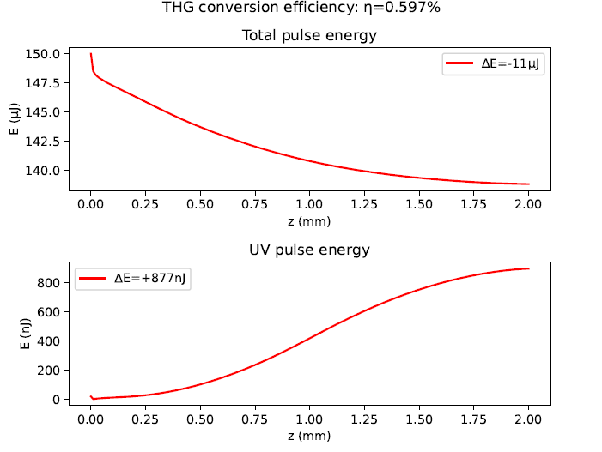
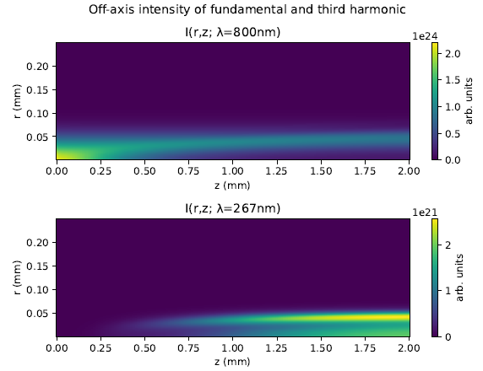
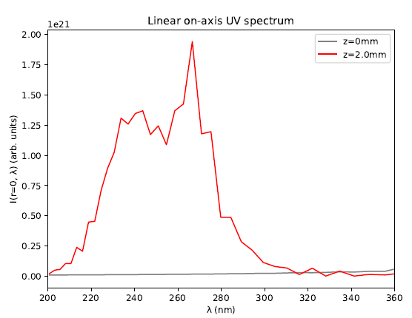
Next steps
Carried out a test run at 1.6bar:
No evidence of filamentation!
Density model breaks down at high central pressure?
Missing nonlinear effect?

